Slide 1
Team #1
Jiangfeng (Leia) Lin
Maryam Foroozandeh
Chris Rollins a.k.a. “Game Master”
Eric Huang a.k.a. “The Artist”
Jakin Wang a.k.a. “flaming Mac users again”
Maria Gorbunova

Slide 2
PLAN OF ATTACK:
Game Overview
Diagrams
Class Relationships
Game Demonstration
How it is played
Use a backdoor
Show off some of the cool features of the game
Requirements Completed
Libraries
Polymorphism
Namespaces
Exception handling
STL containers
C++ 11 features
Style guidelines
Summary

Slide 3
Game Overview
Fun fact: while building the game we created & used:
28 .h & .cpp files
22 .ogg files (sound & music)
3 .dat files (scores)
36 .png files
6 .ttf files
Endless blood, sweat and tears

Slide 4
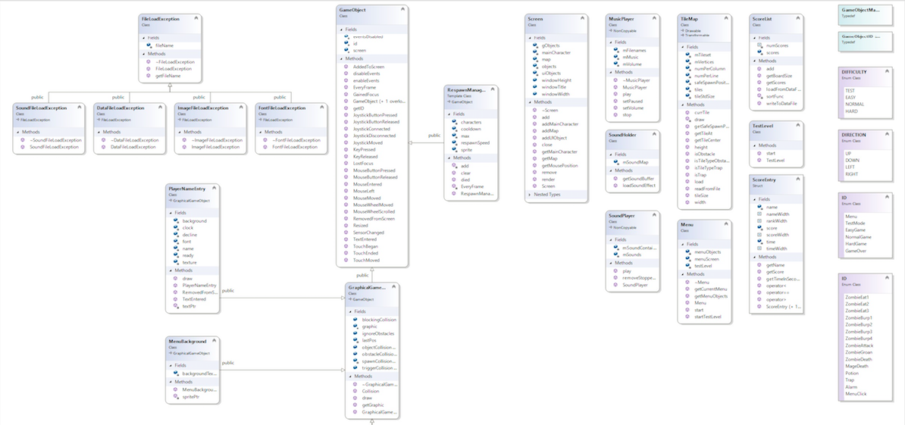
UML Diagram Part 1

Slide 5
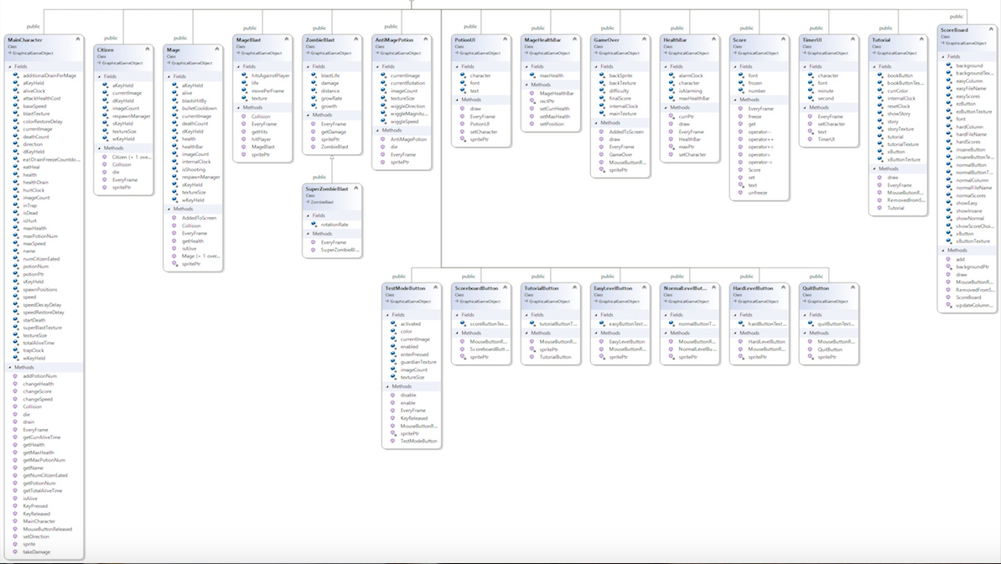
UML Diagram Part 2

Slide 6
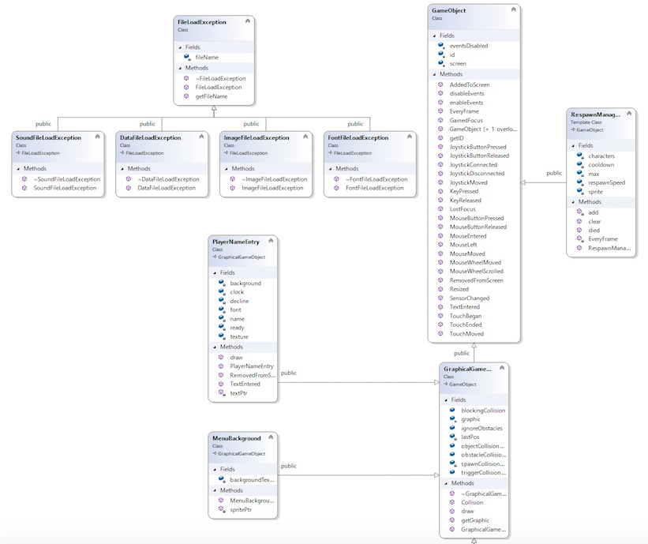
FileLoadException GameObject and its children

Slide 7
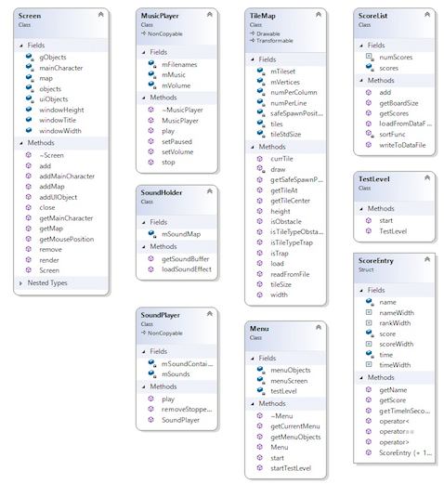
Independent classes

Slide 8
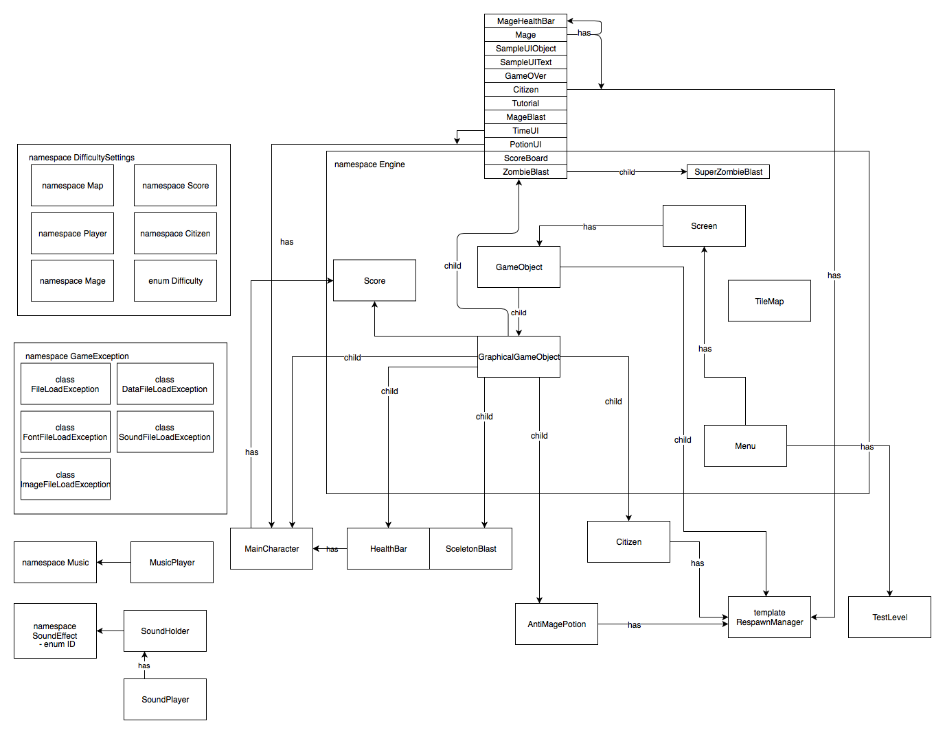
Class Relationships

Slide 9
About the game
Main Character
A zombie who has to eat human in order to survive
Loses Health continuously
WASD (Up, Left, Down, and Right)
Right Mouse Click (Super Attack)
Left Mouse Click (Regular Attack)

Slide 10
Innocent Citizens (aka Food)
Man
Woman
Boy
Girl
Old Man
Old Woman

Slide 11
Weaponized Personnel (extremely dangerous!!!)
Mage
Mage Blast

Slide 12
Extras
Randomly, there will be health potions sitting on the ground. Whenever you eat a health potion you collect one brain and brain can be used as a powerful attack.

Slide 13
TileMap
The character cannot enter the water
2nd tile is the regular ground
3d tile is mud, it slows down the character.

Slide 14
Backdoor option
Press Enter and you will see a hidden option for testing
P.S. You need to know the password!

Slide 15
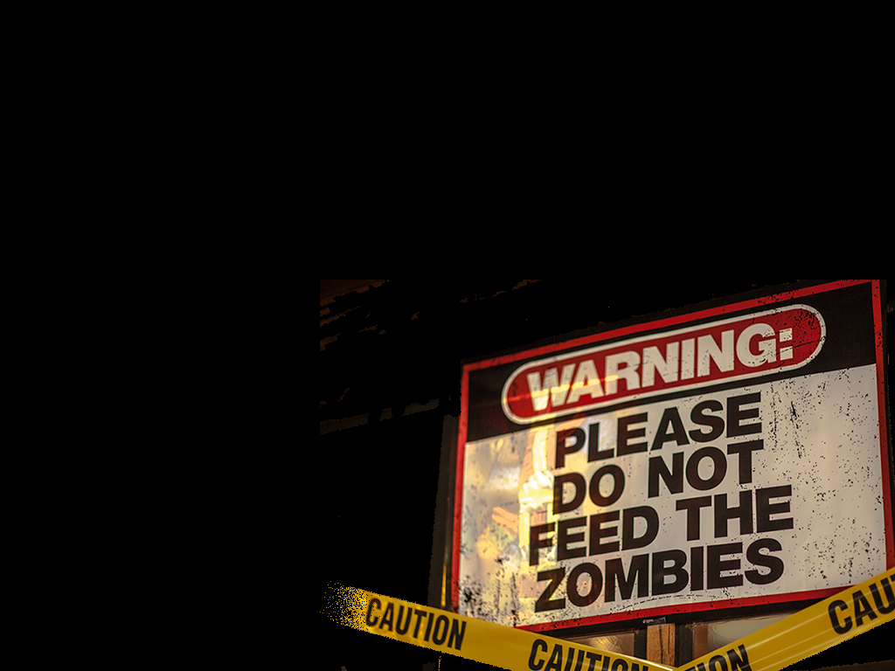
Game Demonstration

Slide 16
What’s next: requirements
Libraries
Polymorphism
Namespaces
Exception handling
STL containers
C++ 11 features
Style guidelines
Overloaded insertion operator

Slide 17
Libraries
SFML libraries:
sfml-graphics.lib
sfml-window.lib
sfml-system.lib
sfml-audio.lib
Our libraries:

Slide 18
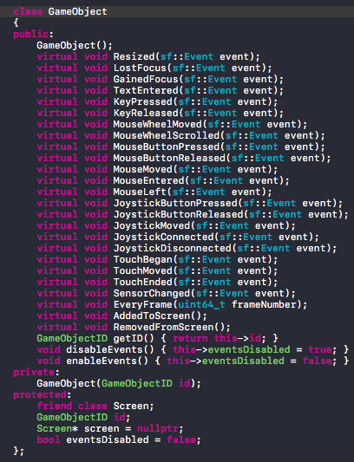
Polymorphism
We used a lot of dynamic casting in our code. A dynamic_cast is used with inheritance to cast a base class pointer or reference to a derived class pointer or references. In order for this to succeed, the base class must be polymorphic (contains a virtual function).

Slide 19
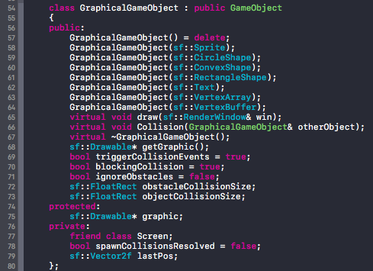
Another polymorphic class:

Slide 20
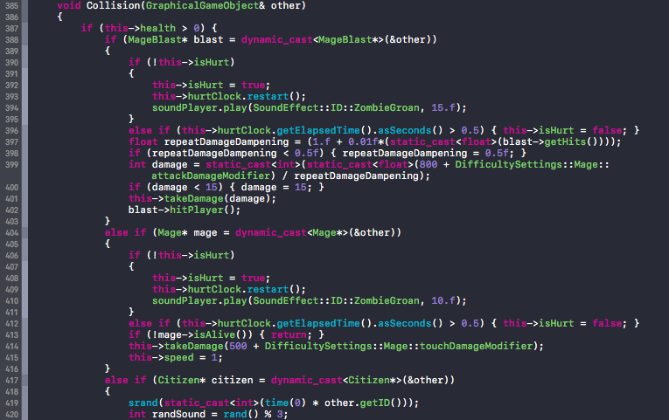
Some of the child classes that we used for dynamic casting - example of using polymorphism

Slide 21
Namespaces
Engine
GameException
DifficultySettings
Map
Player
Mage
Citizen
Score
Music
SoundEffect

Slide 22
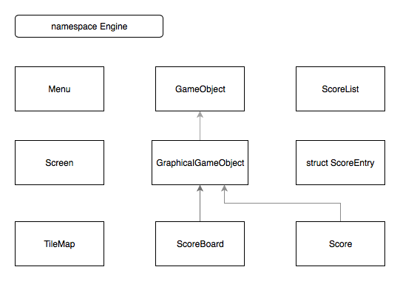
Namespace Engine

Slide 23
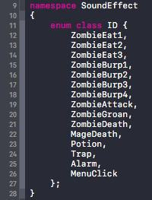
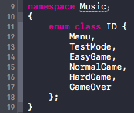
Some other namespaces:

Slide 24
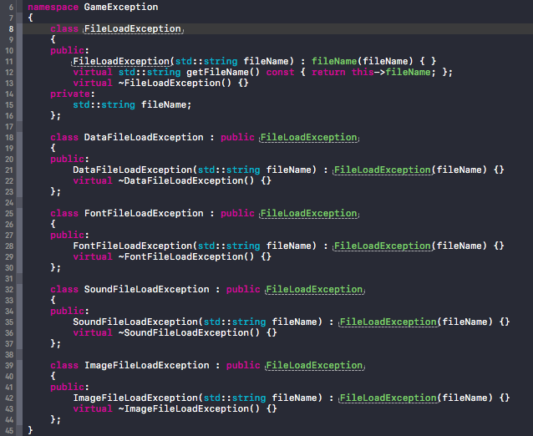
Exception Handling
We created our own custom Exception classes and put them in the namespace GameException.
P.S. Notice the inheritance and use of polymorphic class for getting the filename for a certain Exception class.
P.P.S. And a namespace! ;)

Slide 25
try/catch block
…
// the try/catch block catches exceptions that appear in the game loop, which handles the whole game process
...

Slide 26
Throwing exceptions
Throwing ImageFileLoadException:
Throwing DataFileLoadException:
Throwing SoundFileLoadException:
etc.

Slide 27
STL Containers
#include <vector>
MainCharacter.h - vector is used for the spawn position
Menu.h - keep track of all menuObjects (GameTitle, buttons, etc.)
RespawnManager.h - random spawnPositions
#include <map>
MusicPlayer.h - for keeping track of ID of the music and a filename
SoundHolder.h - for keeping track of ID of the sound and unique ptr to SoundBuffer
RespawnManager.h - all characters that are spawned are controlled with the map
Screen.h - keeps track of all GameObjects on the map by using ID
#include <unordered_set>
Mage.h - unordered_set to handle the collision with MainCharacter’s attacks
#include <queue>
Screen.cpp - queue up objects that need to be removed at the end of the frame
#include <list>
SoundPlayer.h - used to load sound using the namespace SoundEffect::ID from a filename

Slide 28
Overloaded insertion operator
In ScoreBoard.h:

Slide 29
C++ 11 Features used in the game
auto type
nullptr
Range-based for-loop
Initialization list
Deleted constructors
Improved object constructor
Template with typename keyword
lambda function
strongly typed enum
unordered_set

Slide 30
auto type
In Menu.cpp
RespawnManager.h
ScoreBoard.h
Screen.cpp
SoundPlayer.h
TileMap.h
etc.

Slide 31
nullptr
In GraphicalGameObject.h:
In Screen.h:
etc (there’s a lot!)

Slide 32
Range-based for-loop & Initializer list
In Screen.cpp:
In Menu.cpp:
etc.

Slide 33
Deleted constructors
In GraphicalGameObject.h:

Slide 34
Improved object constructor
In MainCharacter.h:
In NormalUIButton:
etc.

Slide 35
Template with typename keyword
In RespawnManager.h:
...
…

Slide 36
Lambda function
In SoundPlayer:

Slide 37
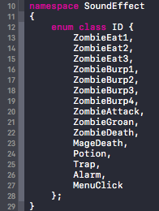
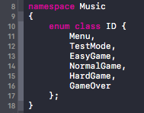
Strongly typed enum
In DifficultySettings.h:
In MageBlast.h:
In MusicPlayer.h & SoundPlayer.h:

Slide 38
unordered_set
In Mage.h:

Slide 39
Style Guidelines
Entity Naming
Names shall begin with a lowercase letter, shall be lower case and words shall begin with an uppercase letter.
Classes shall begin with an uppercase letter.

Slide 40
Indentation and Spacing
Braces shall follow "Indented Style".
The Indented Bracing Style means that the curly brace pair are lined up with the surrounding statement. Statements and declarations between the braces are indented relative to the braces.
Braces without any contents may be placed on the same line. (optional)
Conditional statement braces with only one statement may be placed on the same line as the conditional statement. (optional)
The code looks more consistent if all conditional and loop statements have braces.
Even if there is only a single statement after the condition or loop statement today, there might be a need for more code in the future.
Functions and class methods shall be separated by an additional new line.

Slide 41
Files
File name shall be treated as case sensitive.
C++ source files shall have extension ".cpp".
C++ header files shall have extension ".h".
Header files must have include guards.
The include guard protects against the header file being included multiple times.
System header files shall be included with <> and project headers with "".

Slide 42
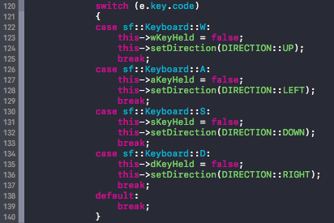
Statements
All switch statements shall have a default label.
Even if there is no action for the default label, it shall be included to show that the programmer has considered values not covered by case labels. If the case labels cover all possibilities, it is useful to put an assertion there to document the fact that it is impossible to get here. An assertion also protects from a future situation where a new possibility is introduced by mistake.

Slide 43
Use the new cast operators
Use dynamic_cast, const_cast, reinterpret_cast and static_cast instead of the traditional C cast notation. These document better what is being performed.
In GameOver.cpp (dynamic and static casting):
Mage.h,
ZombieBlast.h,
MainCharacter.h,
MageBlast,
etc.

Slide 44
this pointer shall be used when referencing class members

Slide 45
Summary Q&A
What would be nice to improve:
NPC not colliding with each other (now they sometimes step on each other)
it would be good if we had a container to manage all the texture, fonts, etc
we could add more stuff on the map
deeper inheritance structure
objects need a better way to communicate to avoid circular-dependency
a base enemy class for all types of enemies with common methods (multiple inheritance)
Strict guideline rules, implemented from the beginning of the project

