Slide 1
Treasure Defense
By Jordan, Ben, Jiawen, Rilun, & Libbi

Slide 2
Agenda
1. Game Overview
Class relationships - UML Diagram
2. Game Demonstration
How to play
Backdoor to show cool features
3. Analysis
Completed requirements
C++11 Features
4. Summary/Suggestions
Reflection

Slide 3
About the Game
Setting: a tower defense type game where the background is a grid of a beach. The left side is a cave with treasure, and enemies approach from the right.
Goal: the overall goal of the game is to protect the treasure as long as possible against the waves of enemies by placing cannons.
Currency: coins are gained by killing monsters. The coins will be used for purchase of more cannons or upgraded cannons.
Points: points are related to the length of survival. Every thirty seconds, players reach new levels where the game becomes more difficult.

Slide 4
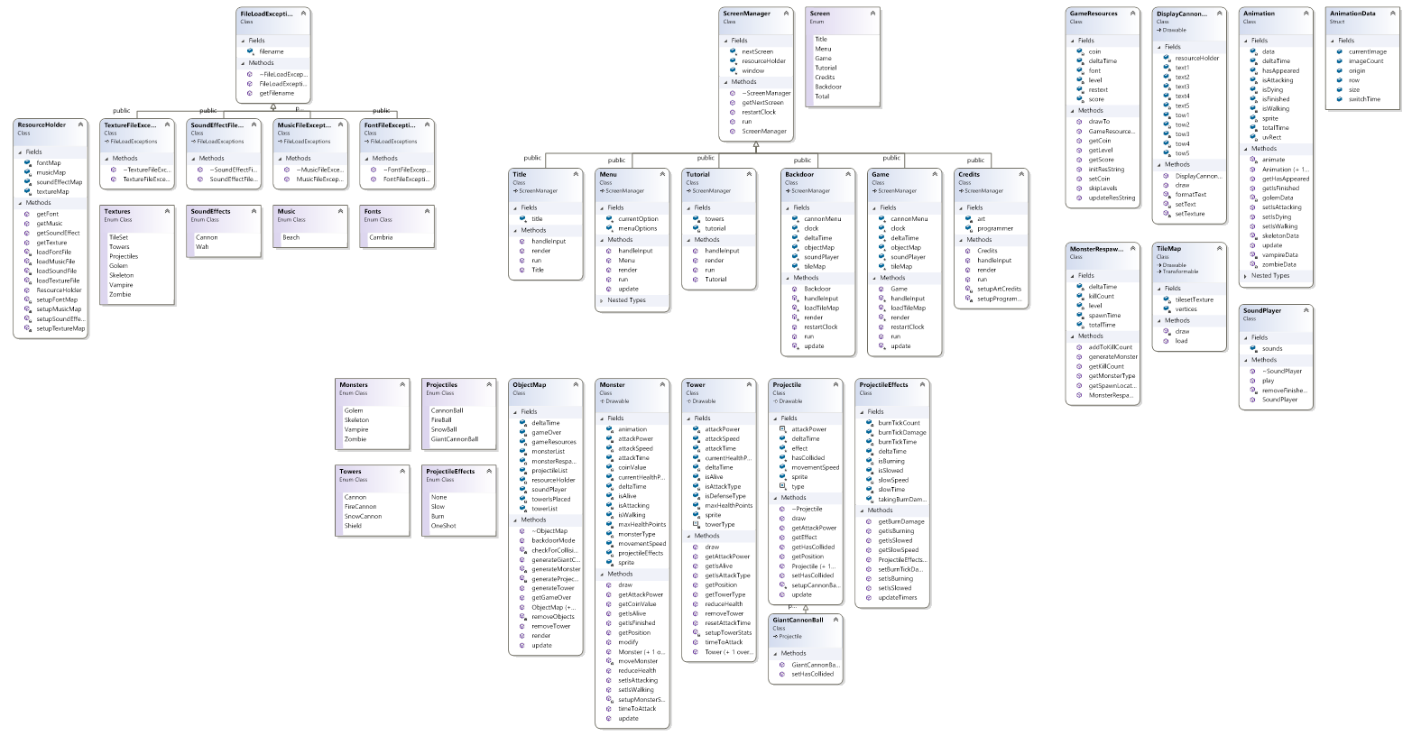
UML Diagrams

Slide 5
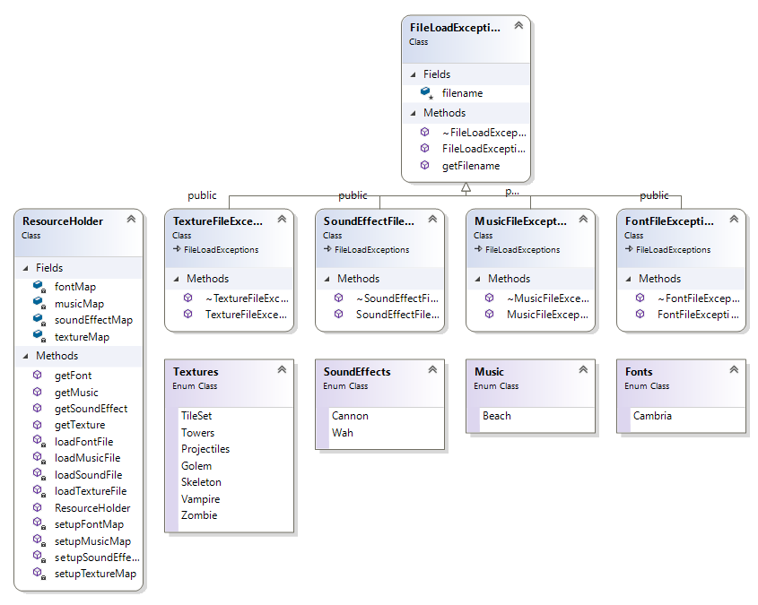
UML Diagrams Contd.

Slide 6
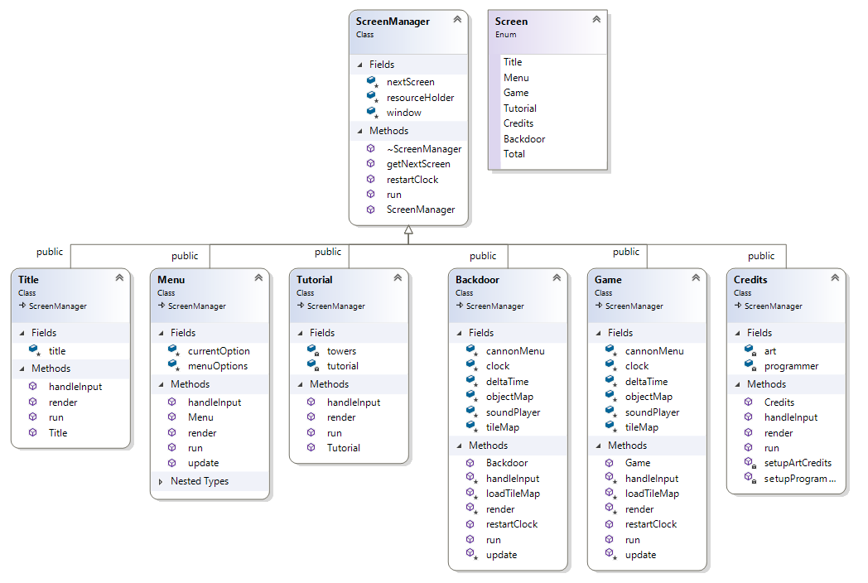
UML Diagrams Contd.

Slide 7
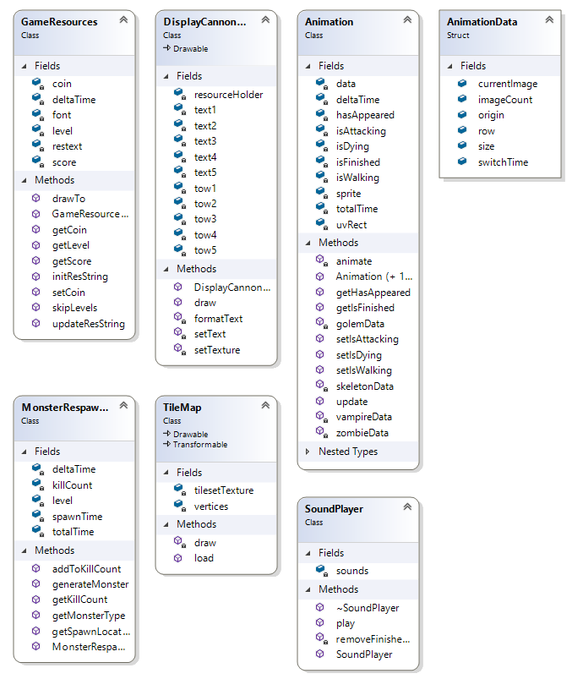
UML Diagrams Contd.

Slide 8
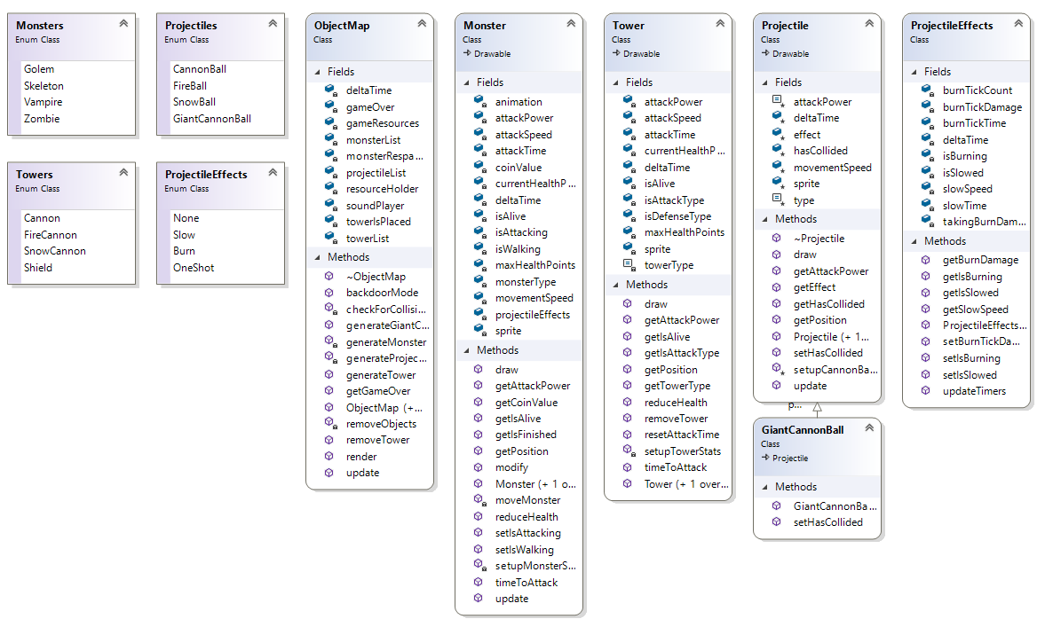
UML Diagrams Contd.

Slide 9
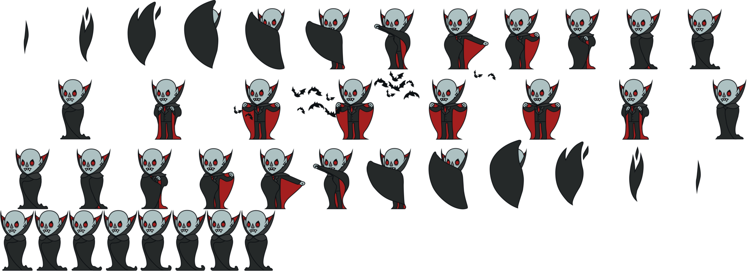
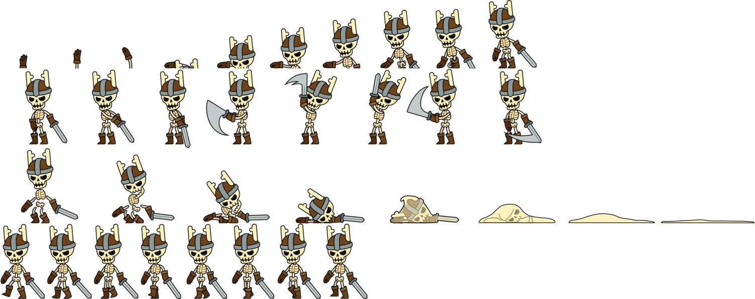
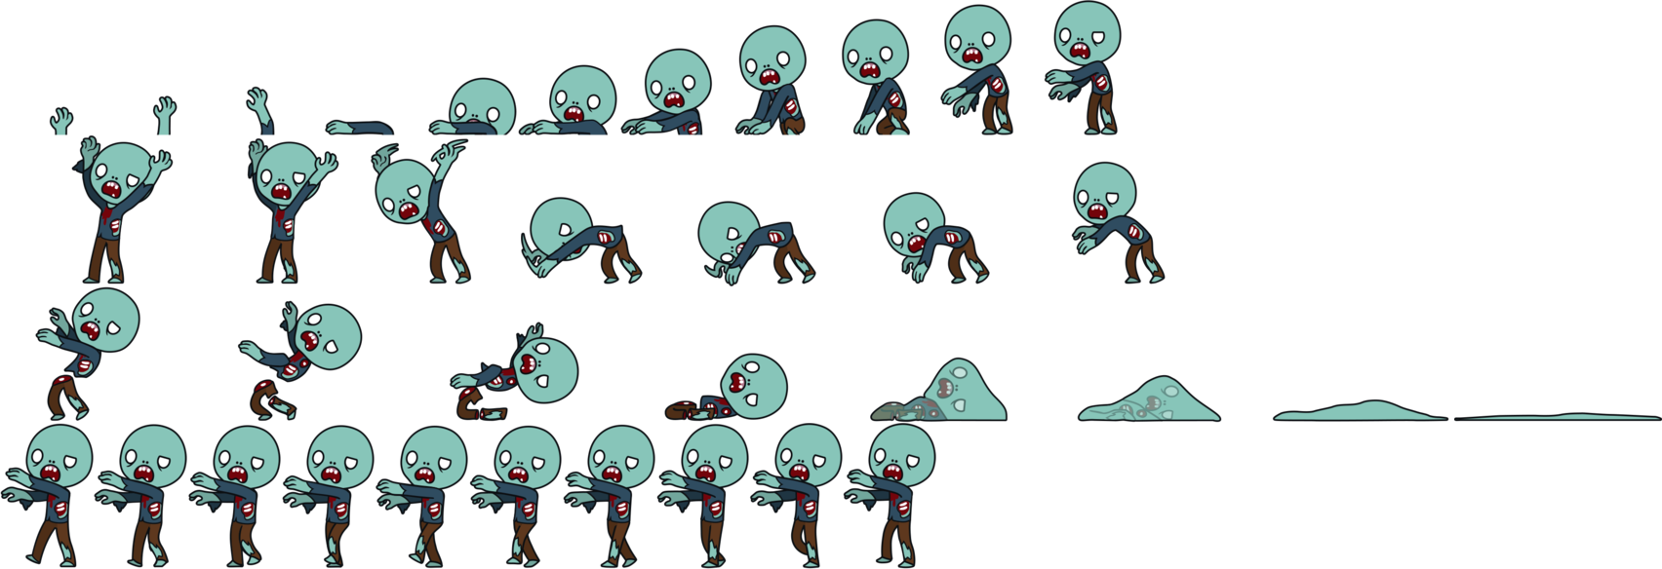
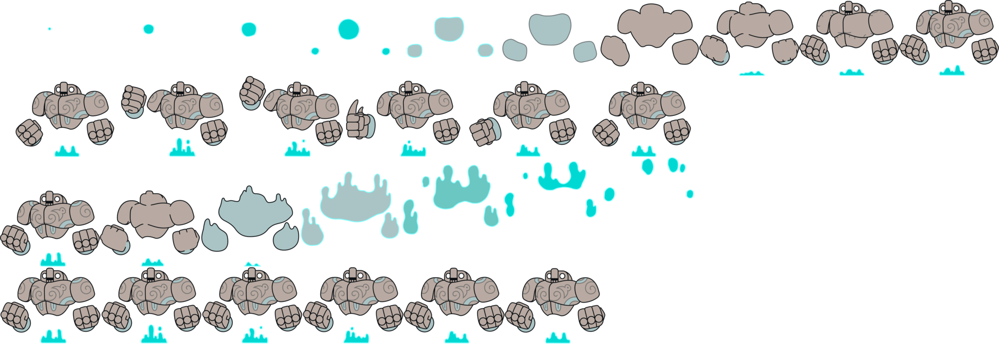
Monsters Sprite Sheets
Vampires
Skeletons
Golems
Zombies

Slide 10


Weapons - Cannons and Cannonball
Cannon Balls -
normal/snowball/fireball/giant ball
Cannon
Fire Cannon
(Higher power)
Snow Cannon
(Slow down)

Slide 11

TileMap
1st and 2nd tiles: beach tile with waves
3rd and 4th tiles: beach tiles with two different colors
5th and 6th tiles: beach tiles with added shells
7th, 8th, 9th, 10th, 11th tiles: cave with treasure tiles

Slide 12
Backdoor Option
Debugging
  Jump to different game states
  Two game loops
Game balance
  Resource management
  Difficulty
    Enemy movement speed
    Enemy frequency

Slide 13
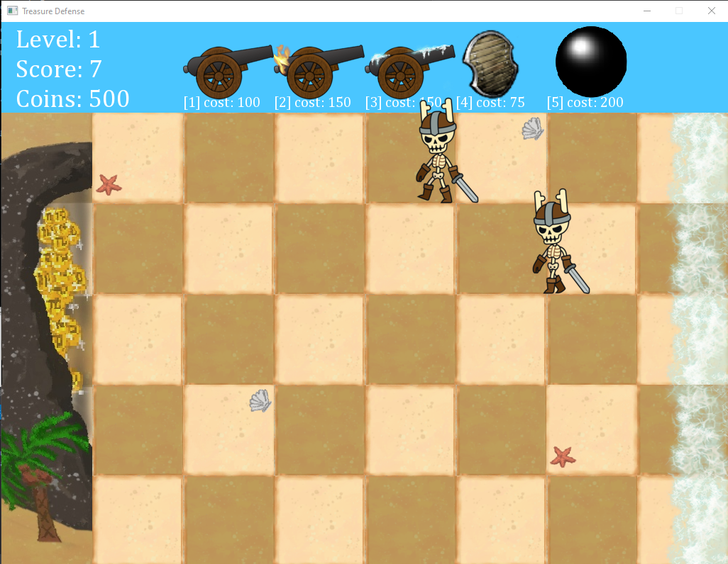
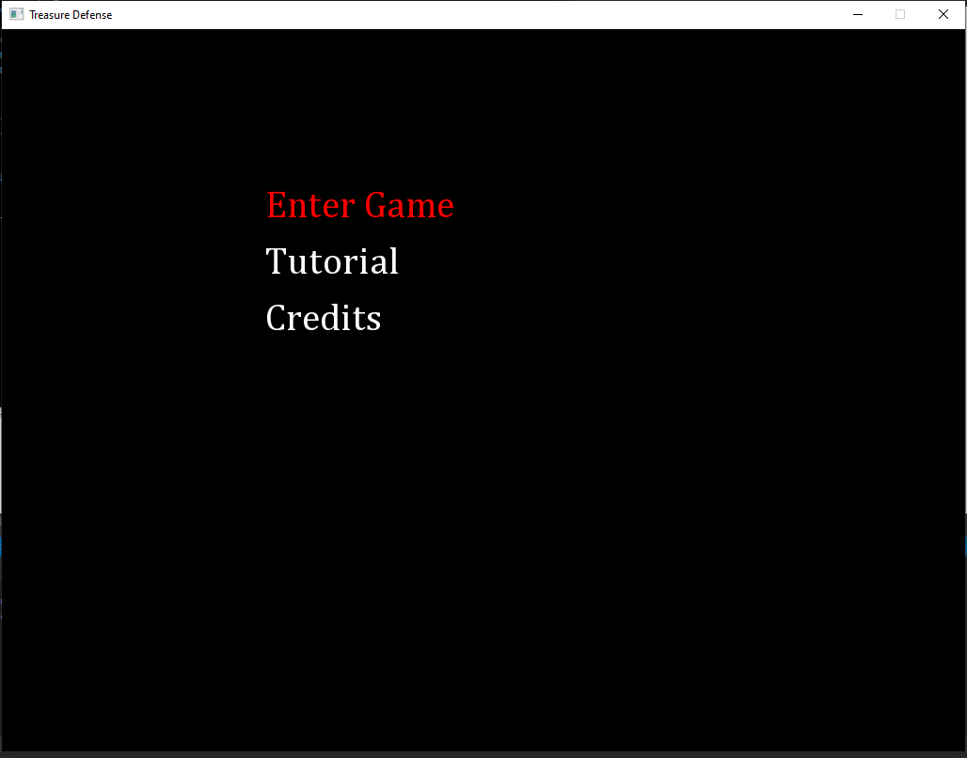
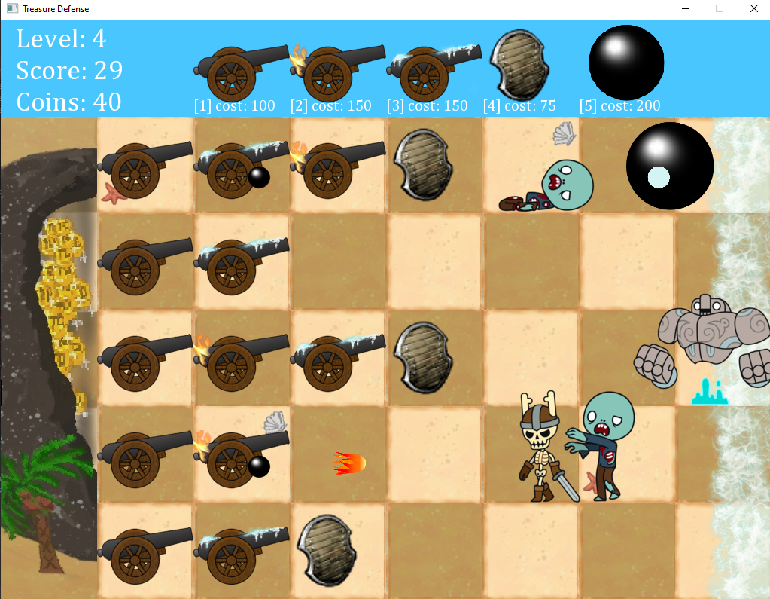
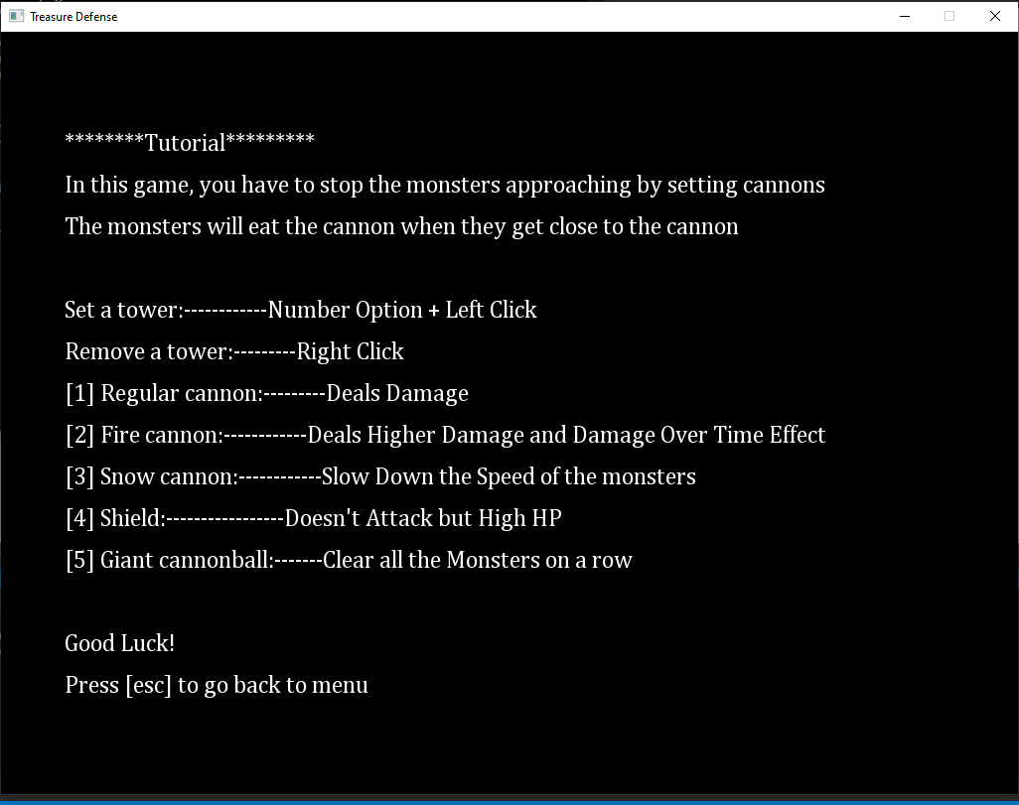
Game Demo

Slide 14
Completed Requirements
Libraries & Exceptions
Polymorphism
Namespaces
Sound
STL Containers - Vector, List, Map
Overloaded Insertion Operators
C++11 Features
Style Guidelines

Slide 15
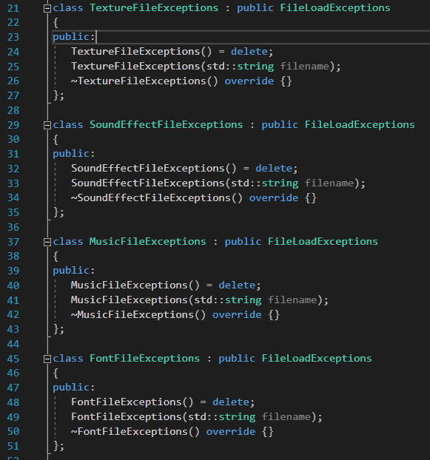
Libraries & Exceptions
Library
  FileLoadExceptions.a
Exceptions used
  Texture files
  Sound files
  Music files
  Font files

Slide 16
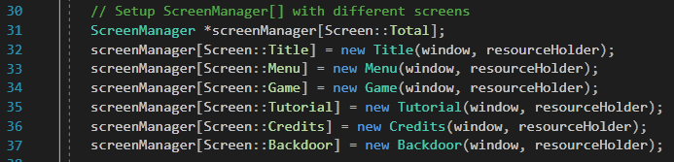
Polymorphism
The Screenmanager - each screen is derived from ScreenManager base class
screenManager is an array of pointers to different screen objects (Title, Menu, Game, etc)
There is a pure virtual function in the ScreenManager class, so the ScreenManage cannot be declared as an object.
There is a static variable in the ScreenManager class which hold the index of the next screen that is supposed to be displayed
Enum used to index the array so you don’t have to know which screen belongs to which index

Slide 17
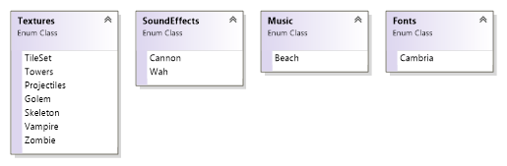
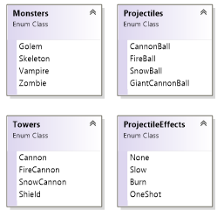

Namespaces
namespace Resources namespace GameObjects

Slide 18
STL Containers - Vector
Vector: The monsters will be randomly generated and stored in a vector. When game object is running, an array of vector will be iterated in order to check if there are buildings around each monster. If yes, that monster will stop and start attacking the building nearby.
  std::vector <Monster *> monsterList[5];
  monsterList[spawnLocation].push_back(newMonster);
  for (auto monster = monsterList[row].begin(); monster != monsterList[row].end(); ++monster)
  {
  if ((*monster)->getIsFinished())
  {
  monsterRespawnManager.addToKillCount();
  delete *monster;
  *monster = nullptr;
  monsterList[row].erase(monster);
  resources.setCoin(10);
  break;
  }
  }

Slide 19
STL Container - List
When a projectile is generated, it will be stored in a list. There are totally 5 list of projectiles, and each projectile has its position as a member data.
  std::list <Projectile *> projectileList[5];
  projectileList[row].push_back(newProjectile)
  projectileList[row].erase(projectile);
  Projectile *newGiantCannonBall = new GiantCannonBall(deltaTime, position, resourceHolder.getTexture(ID::Projectiles));
  projectileList[row].push_back(newGiantCannonBall);

Slide 20
STL Container - Map
The resource that the game needs are stored into STL containers - map
To get the texture used for the golem sprite sheet use the key
Resources::Textures::Golem
Returns the correct texture by reference

Slide 21
Overloaded Insertion Operators
Overloaded insertion operator is used for displaying a message in console when a cannon is set by the user.
std::ostream& operator<< (std::ostream& out, const Tower& tow)
{
switch(tow.getTowerType())
{
case Towers::Type::Cannon:
out << "A cannon is set at ";
break;
case Towers::Type::FireCannon:
out << "A fire cannon is set at ";
break;
case Towers::Type::SnowCannon:
out << "A snow cannon is set at ";
break;
case Towers::Type::Barricade:
out << "A Barricade is set at ";
break;
default:
break;
}
return out;
}
…….
std::cout << *towerList[row][col] << "(" << row + 1 << " , " << col + 1 << ")" << std::endl;

Slide 22
C++11 Features
strongly typed enum:
enum class Textures { TileSet, Towers, Projectiles, Golem, Skeleton, Vampire, Zombie };
auto type and range-based for loop is used for iterator of STL containers
for (auto monster : monsterList[row]){ ……. }
nullptr: nullptr is used when tower(cannon) is not set
for (int row = 0; row < 5; row++){
for (int col = 0; col < 6; col++){
towerIsPlaced[row][col] = false;
towerList[row][col] = nullptr;
}
}

Slide 23
C++11 Features Contd.
unique pointer:
std::unique_ptr<sf::Texture> towersTexture(new sf::Texture());
std::unique_ptr<sf::Texture> projectilesTexture(new sf::Texture());
std::unique_ptr<sf::Texture> golemTexture(new sf::Texture());
std::unique_ptr<sf::Texture> skeletonTexture(new sf::Texture());
std::unique_ptr<sf::Texture> vampireTexture(new sf::Texture());
std::unique_ptr<sf::Texture> zombieTexture(new sf::Texture());
initializer list:
Game::Game(sf::RenderWindow &window, ResourceHolder &resourceHolder) : ScreenManager(window, resourceHolder)
{
objectMap = new ObjectMap(deltaTime, resourceHolder);
loadTileMap();
}

Slide 24
Style Guidelines - Names
1. Names should be descriptive. Other team members should have an idea what the variable/function is for just based on the name. Descriptiveness should be proportional to scope.
2. Class – UpperCamelCase, first letter of every word capitalized.
  class MyClass
3. Functions/Variables – lowerCamelCase, first letter lowercase and the first letter of subsequent words in uppercase.
  void someFunction()
  int someVariable

Slide 25
Style Guidelines - Names Contd.
4. Constants – written in uppercase and characters separated by underscores.
  int SOME_CONSTANT
5. Exdented indentation style - This style puts the brace associated with a control statement on the next line, indented to the same level as the control statement. Statements within the braces are indented to the next level.

Slide 26
Style Guidelines - Indentation and Spacing
6. Use curly braces for one statement loops/conditional statements.
  while (x==y)
  {
something();
  }
Optional to put short if statements body on the same line
7. Braces without any contents may be placed on the same line.
  Thing::~Thing() {}

Slide 27
Style Guidelines - Files
8. C++ sources files must have a “.cpp” extension. C++ header files must have a “.h” extension.
9. Header files must have include guards.
  #ifndef
  #define
  #endif
10. System header files must be included with <>; and project headers files with “”.
11. Use static_cast, const_cast, reinterpret_cast, and static_cast. Do not use C style casts.

Slide 28
Summary & Suggestions
What worked?
What didn't work?
What did you learn? Github, SFML, Read different codes, Use group member’s code, Get used to different coding style ...
What to improve on? better graphics, more sound effects, tracking high score,
Was the project a good idea? Worth the time? YES!
What do you thinking of working in a group and depending on others?
What are you most proud of?

